Slide 1
Principles in Leadership
“If you want to win in the 21st Century, you have to empower others, making sure other people are better than you. Then you will be successful.”
- Jack Ma
Mr. Rolfe

Slide 2
Principles in Leadership Day 5
Today we are going to:
1. Take a quiz
2. Turn in Team Project #1 and fill out Peer Evaluation forms
3. Discuss the use of Grammatical Moods in English
4. Discuss the reasons why working together is important
5. Explore the effects of following and leading well

Slide 3
Put your cellphone on your desk where I can see it and only use it in class to look up something you don’t understand or to take a photo of ppt.

Slide 4

Homework Check
Put your homework out on your desk for me to come around and look at. I may ask you questions about it, so please be ready!

Slide 5
Team Project #1
The leader of each team will come to the front and turn in the printed menu and the PDF file to the teacher. Then the leader will bring the Peer Evaluation forms back to their team. The team will fill out the Peer Evaluation forms and turn them in at the beginning of next class.
Filling out the Peer Evaluation forms:
Fill out every blank.
Be honest in your evaluations.
Comments will remain anonymous.

Slide 6
The Grammatical Mood
In English, the state of being of the verb is called its mood. If the speaker of the sentence is expressing something to definitely be the case, then the verb is in the indicative mood. If the speaker is asking a question, then the verb is in the interrogative mood. If the speaker is commanding something, then the verb is in the imperative mood. But if the speaker is describing a situation that may not be real, then the verb is in the subjunctive mood.
Indicative John will drive the car to the store.
Interrogative Will John drive the car to the store?
Imperative John, drive the car to the store!
Subjunctive If John drives the car, then it will be to the store.

Slide 7
Let’s practice!
With your partner, complete the worksheet on the grammatical moods of sentences. Discuss the worksheet in English only!

Slide 8
Your Favourite Leader
Describe the leader from your homework to your partner. As you listen to your partner, write an indicative statement about that leader.

Slide 9
Let’s take a 5 minute break!

Slide 10
Working Well with Others
“The ability to work well with others is one of the most sought-after skills in the global workplace. Individuals, however talented, can seldom produce better results than those who learn to work with a team.”
- Robert Foster, Modern Leadership Strategies, pg. 22

Slide 11
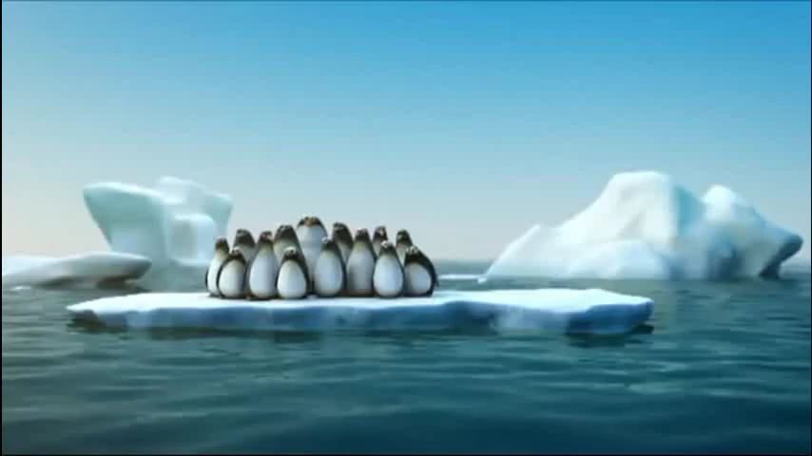

Slide 12
Working Well with Others
When a group of people are working together to accomplish a task or reach a goal, there needs to be a leader. If there is a leader then there must also be followers. Therefore, learning to work well with others is needed by both the leader and the follower.
As a leader: leadership styles and skills are directly effected by how the leader views their followers.

Slide 13
How should a leader view a group of followers?
In groups of four, discuss the different ways (good and bad) in which a leader can view their followers. Which way do you think is the best way?
A leader’s view of their followers can influence how they choose to lead:
A herd of sheep (mindless, helpless followers)
A company of employees (incentive driven parts of a machine)
A military army (units used for conquest which are expendable)
A young family (need autocratic leadership with heavy responsibility)
A sports team (players accomplishing a goal together)
Being a good follower can go a long way toward developing the best strategies for being a good leader.

Slide 14
Working Well with Others
When a group of people are working together to accomplish a task or reach a goal, if there is a leader then there must also be followers. Therefore, working well with others is needed by both the leader and the follower.
As a leader: leadership styles and skills are directly effected by how the leader views their followers.
As a follower: learning to listen and follow leadership are great skills for future (aspiring) leaders to learn.

Slide 15
The Importance of Following
We cannot all be leaders all the time. In order for someone to lead successfully, others must follow. Learning to follow well will make you a better leader when it is your turn.
Learning to follow is hard for natural leaders, so it requires effort and discipline to follow well.
Learning to follow gives a natural leader a chance to see how important good leadership is to the team.
Learning to follow lets a natural leader see how hard it is when people don’t follow.

Slide 16
Build Your House
Get in your teams. On the piece of paper Mr. Rolfe gives you, draw a picture of the house on the slide with one, single pen or marker. However, as you are drawing the picture, every team member must be touching the marker at all times and guiding it. See which team can draw the picture the fastest. Wait until Mr. Rolfe says to start!

Slide 17
Homework
Read and complete the exercises for Days 5 and 6 in the textbook, Modern Leadership Strategies from Ancient Chinese Wisdom.
Fill out your Peer Evaluation forms for Team Project #1.
Bring shoes that are good for going outside during class.

